Slide 1
Statistics and Probability- 1

Slide 2
Introduction
Statistics and Probability are the building blocks of the most revolutionary technologies in today’s world. From Artificial Intelligence to Machine Learning and Computer Vision, Statistics and Probability form the basic foundation to all such technologies.
Statistics is a branch of mathematics that deals with collecting, analyzing, interpreting, and visualizing empirical data.
Descriptive statistics and inferential statistics are the two major areas of statistics.
Descriptive statistics are for describing the properties of sample and population data (what has happened).
Inferential statistics use those properties to test hypotheses, reach conclusions, and make predictions (what can you expect).

Slide 3
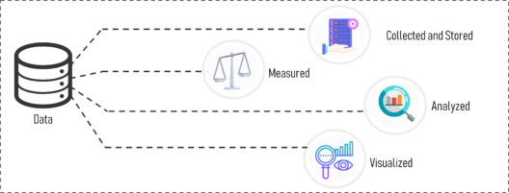
What Is Data?
Data is all around us, especially when we use our phones. Every click creates a lot of data. We can use this data to learn things and make smarter choices in business. That's why data is really important.
Data means information like facts and numbers that we gather to study or understand things better.
We collect data, measure it, and then study it using graphs or charts to see patterns or trends.

Slide 4
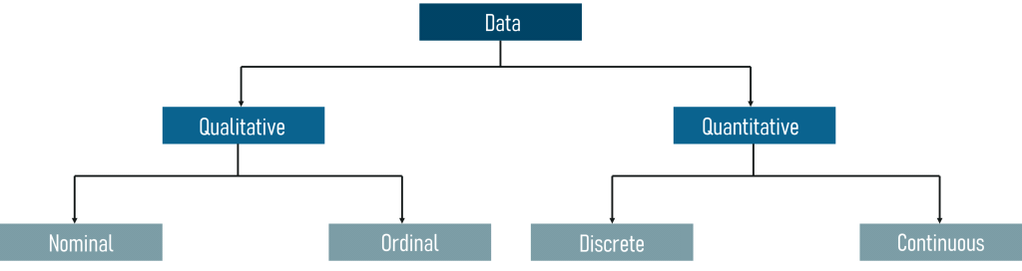
Categories Of Data
We can divide data into two types:
Qualitative Data
Quantitative Data
Look at the picture below to see what each type means.

Slide 5
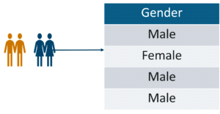
Qualitative Data: This type of data is about qualities or descriptions that we can't measure easily but can see or feel. It's divided into two kinds:
Nominal Data: This is data without any specific order, like categories such as gender or race.

Slide 6
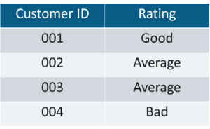
Ordinal Data: It's data that's arranged in a specific order, like a list from first to last.

Slide 7
Quantitative Data: This type of data is about numbers and things we can measure clearly. It's split into two types:
Discrete Data: This is like categories with a set number of choices. For instance, how many students are in a class.
Continuous Data: This is data that can vary smoothly and doesn't have a specific limit. Like how much someone weighs.
Now, let's dive into some basic math concepts about statistics.

Slide 8

What Is Statistics?
Statistics is about collecting, studying, understanding, and showing information from data.
This type of math helps us figure out tricky problems using data. For example:
1. If your company made a new medicine for cancer, how would you check if it really works?
2. Imagine you're at a baseball game and your friend bets no one will hit a home run. Should you take the bet?
3. Your boss wants a report on how the company can do better based on sales data. What should you look at and what should you ignore?
We can solve these problems using statistics.

Slide 9
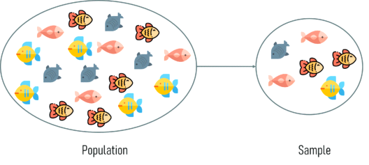
Before getting into the details of Statistics, it's essential to know some basic terms. Two key terms are population and sample.

Slide 10
Population: It's a group of people, things, or events that we want to study. For instance, in an election, the population would be all the voters eligible to vote.
Sample: This is a smaller group taken from the population. It's like a mini-version of the whole population. For example, if we want to know what new voters think, we might take a sample of them for a survey.
Choosing a good sample means picking a group that gives us a good idea of what the whole population is like.

Slide 11
Sampling is when we pick some observations from a big group to learn about the whole group. Imagine you're asked to study how teenagers in the US eat. With over 42 million teens, you can't ask every single one, right? That's where sampling comes in. You pick a smaller group to study and learn about the entire population.
There are two main types of sampling:
1. Probability Sampling: This is when each person or thing in the population has an equal chance of being picked for the sample.
2. Non-Probability Sampling: Here, not everyone has an equal chance of being selected.

Slide 12
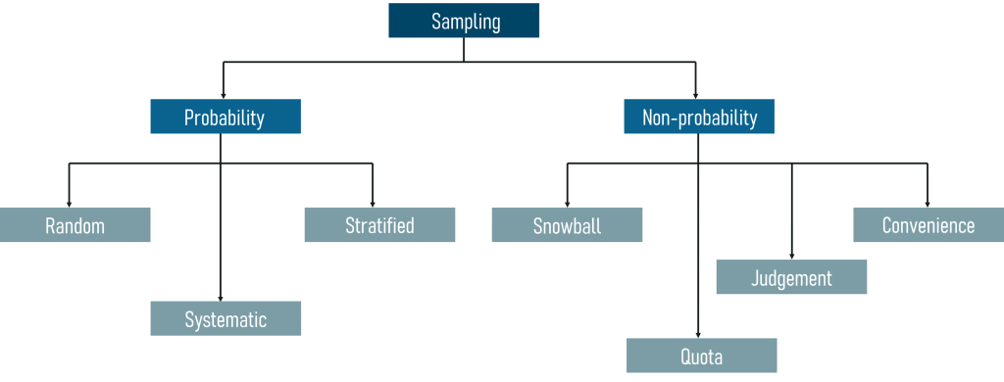

Slide 13

We'll stick to probability sampling techniques for now, as non-probability sampling isn't part of this discussion.
Probability Sampling involves using probability theory to select samples from a large population. There are three main types:
1. Random Sampling: Here, every member of the population has an equal chance of being chosen for the sample.

Slide 14
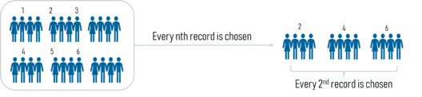
2. Systematic Sampling: Here, we pick every nth record from the population to be part of the sample. Take a look at the figure below to see how Systematic sampling works visually.

Slide 15
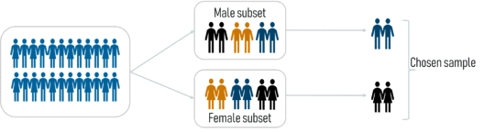
Stratified Sampling: In Stratified Sampling, we divide the population into smaller groups called strata, based on common characteristics. Then, we use random sampling within each stratum to pick enough subjects for the sample.

Slide 16
Types of Statistics
Statistics can be broadly classified into two types:
1. Descriptive Statistics
2. Inferential Statistics
Descriptive Statistics
Descriptive statistics involves summarizing and explaining the features of a dataset. It provides concise summaries and measures of the data, focusing on its main characteristics. Descriptive statistics often include graphical representations to help understand the data better.

Slide 17
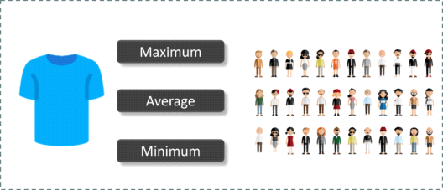
Let's say you're planning to gift t-shirts to all your classmates. In descriptive statistics, you would first note down the shirt sizes of all students in the class. Then, you'd calculate the maximum, minimum, and average shirt size to understand the overall size trend in the class.

Slide 18

Inferential Statistics
Inferential statistics involves making predictions and inferences about a whole population based on a smaller sample from that population. It uses probability to draw conclusions and generalize findings from the sample to the entire population.
For instance, if you're trying to find the average shirt size of students in a class using Inferential Statistics, you would first take a sample of students, which represents the entire class. This sample would already be grouped into categories like large, medium, and small. Then, using statistical models, you would extend these findings to the whole class to estimate the average shirt size.

Slide 19
Descriptive Statistics can be divided into two main categories:
1. Measures of Central Tendency
2. Measures of Variability (Spread)
Measures of Central Tendency summarize a dataset by indicating its central or typical value.
There are three primary measures of central tendency:

Slide 20
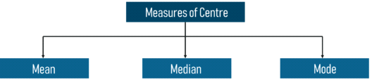
Mean: The average value of all the numbers in a sample is called the Mean.
Median: The middle value of the sample set is known as the Median.
Mode: The most frequently occurring value in the sample set is called the Mode.
To grasp the concept of Measures of Central Tendency better, let's consider an example using the cars dataset below, which includes the following variables:

Slide 21
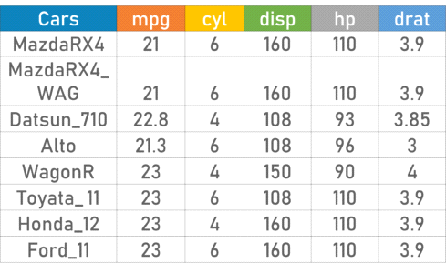
Cars
Mileage per Gallon(mpg)
Cylinder Type (cyl)
Displacement (disp)
Horse Power(hp)
Real Axle Ratio(drat)
Using descriptive Analysis, you can analyze each of the variables in the sample data set for mean, standard deviation, minimum and maximum.

Slide 22
If we want to find out the mean or average horsepower of the cars among the population of cars, we will check and calculate the average of all values. In this case, we’ll take the sum of the Horse Power of each car, divided by the total number of cars:
Mean = (110+110+93+96+90+110+110+110)/8 = 103.625
If we want to find out the center value of mpg among the population of cars, we will arrange the mpg values in ascending or descending order and choose the middle value. In this case, we have 8 values which is an even entry. Hence we must take the average of the two middle values.
The mpg for 8 cars: 21,21,21.3,22.8,23,23,23,23
Median = (22.8+23 )/2 = 22.9
If we want to find out the most common type of cylinder among the population of cars, we will check the value which is repeated the most number of times. Here we can see that the cylinders come in two values, 4 and 6. Take a look at the data set, you can see that the most recurring value is 6. Hence 6 is our Mode.

Slide 23
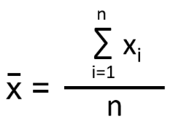
Python Implementation-
Mean:
The arithmetic mean is the average of all the data points.
If there are n number of observations and xi is the ith observation, then mean is:

Slide 24
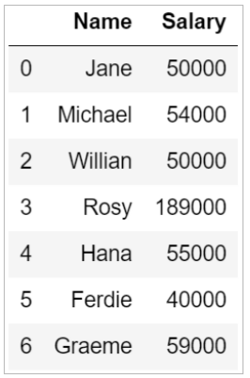
Consider the data frame below that has the names of seven employees and their salaries.

Slide 25
To find the mean or the average salary of the employees, you can use the mean() functions in Python.
Median:
Median is the middle value that divides the data into two equal parts once it sorts the data in ascending order.
If the total number of data points (n) is odd, the median is the value at position (n+1)/2.
When the total number of observations (n) is even, the median is the average value of observations at n/2 and (n+2)/2 positions.

Slide 26
The median() function in Python can help you find the median value of a column. From the above data frame, you can find the median salary as:
Mode:
The mode is the observation (value) that occurs most frequently in the data set. There can be over one mode in a dataset.
Given below are the heights of students (in cm) in a class:
155, 157, 160, 159, 162, 160, 161, 165, 160, 158
Mode = 160 cm
The mode salary from the data frame can be calculated as:

Slide 27
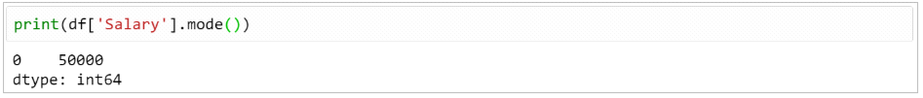

Slide 28

Measures Of The Spread:
A measure of spread, also known as a measure of dispersion, helps describe how much variation there is in a sample or population.

Slide 29
We also have measures of spread, which include the following:
Range: This measure indicates how spread out the values in a dataset are. It's calculated as:
Range = Maximum value of x - Minimum value of x

Slide 30
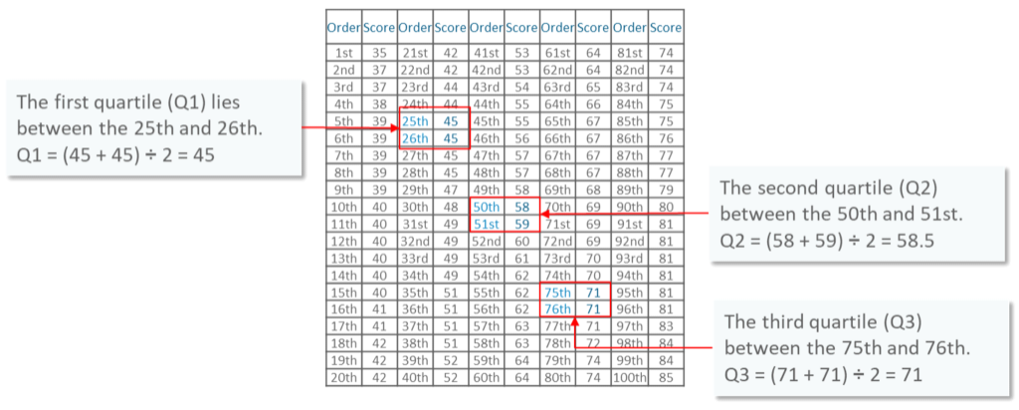
Quartiles divide a dataset into quarters, similar to how the median divides it in half, giving us insights into the data's spread.
To better grasp how quartiles and the Interquartile Range (IQR) are calculated, let's consider an example.

Slide 31
The image above displays the marks of 100 students arranged from lowest to highest scores. The quartiles are found within these ranges:
- The first quartile (Q1) falls between the 25th and 26th observations.
- The second quartile (Q2), also known as the median, falls between the 50th and 51st observations.
- The third quartile (Q3) falls between the 75th and 76th observations.
Interquartile Range (IQR) measures variability by dividing the data set into quartiles. It's calculated as the difference between Q3 and Q1: IQR = Q3 - Q1.

Slide 32
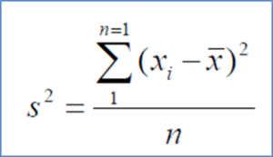
Variance quantifies the extent to which a random variable deviates from its expected value. It involves calculating the squares of deviations from the mean. The formula for variance is as follows:
Where:
x: Individual data points
n: Total number of data points
x̅: Mean of data points

Slide 33

Deviation is the difference between each element from the mean. It can be calculated by using the below formula:
Deviation = (𝑥_𝑖 – µ)
Population Variance is the average of squared deviations. It can be calculated by using the below
Formula:

Slide 34

Sample variance is the average of squared differences between each data point and the mean. It's calculated using the following formula:

Slide 35
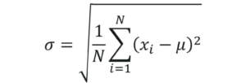
Standard deviation measures how spread out a set of data is from its mean. It's calculated using the following formula:

Slide 36
To better understand how the Measures of spread are calculated, let’s look at a use case.
Problem statement: Daenerys has 20 Dragons. They have the numbers 9, 2, 5, 4, 12, 7, 8, 11, 9, 3, 7, 4, 12, 5, 4, 10, 9, 6, 9, 4. Work out the Standard Deviation.
Let’s look at the solution step by step:
Step 1: Find out the mean for your sample set.
The mean is = 9+2+5+4+12+7+8+11+9+3

Slide 37
Then work out the mean of those squared differences.
+7+4+12+5+4+10+9+6+9+4 / 20
µ=
Step 2: Then for each number, subtract the Mean and square the result.
(x_i – μ)²
(9-7)²= 2²=4
(2-7)²= (-5)²=25
(5-7)²= (-2)²=4
And so on…
We get the following results:
4, 25, 4, 9, 25, 0, 1, 16, 4, 16, 0, 9, 25, 4, 9, 9, 4, 1, 4, 9
Step 3: Then work out the mean of those squared differences.

Slide 38
4+25+4+9+25+0+1+16+4+16+0+9+25+4+9+9+4+1+4+9 / 20
⸫ σ² = 8.9
Step 4: Take the square root of σ².
σ = 2.983

Slide 39
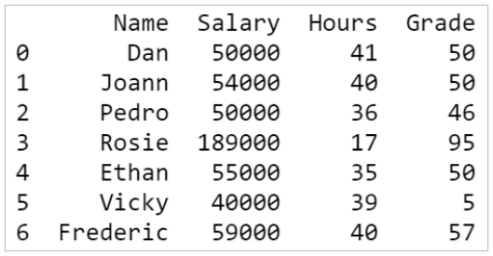
Python Implementation-

Slide 40
To calculate the variance of the Grade, use the following:
You can find the standard deviation using the std() function in Python.

Slide 41
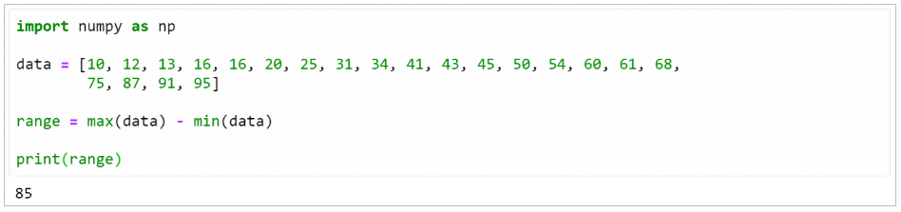
Range:
The Range in statistics is the difference between the maximum and the minimum value of the dataset.

Slide 42
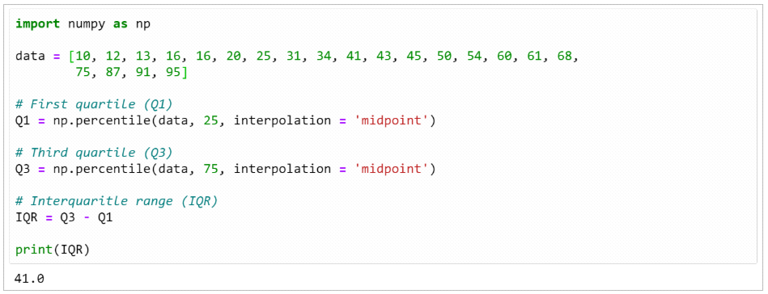
Interquartile Range (IQR) :
The IQR is a measure of the distance between the 1st quartile (Q1) and 3rd quartile (Q3).

